Slide 1
2016-17 GLADiS Portfolio Support

Slide 2
GLADiS Website
To access GLADiS, go to:
http://www.thegladisproject.com/live4/gladis/welcome

Slide 3
GLADiS Sign In
Enter information here

Slide 4
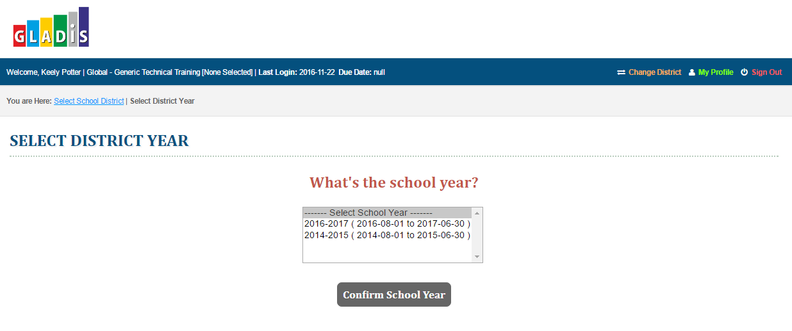
Select District Year
Select year, then click Confirm School Year

Slide 5
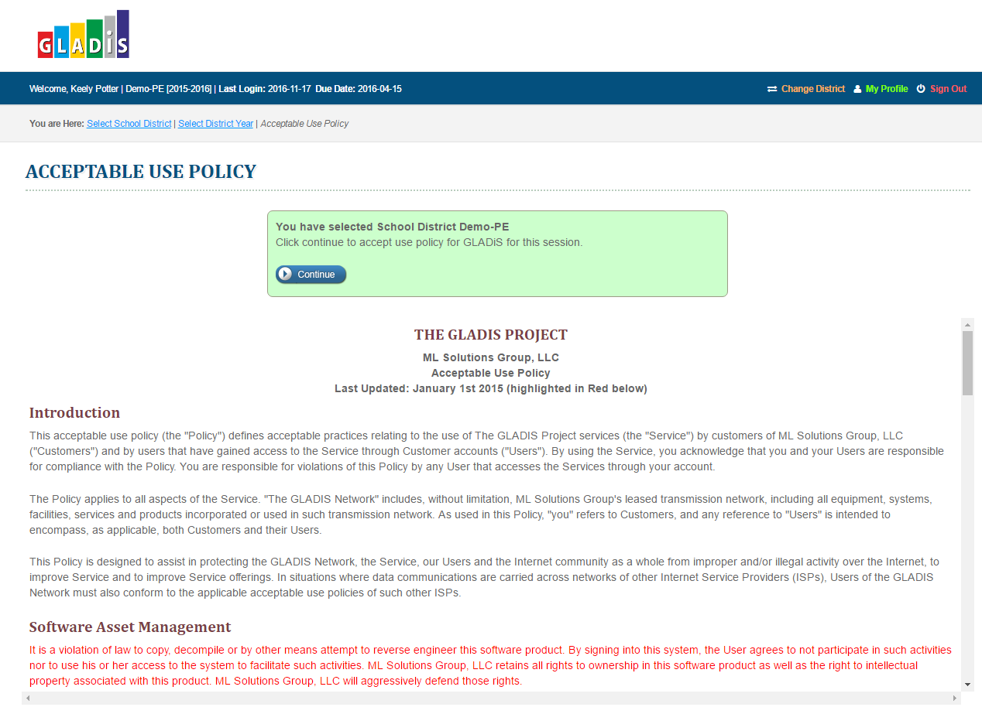
Acceptable Use Policy
Click Continue

Slide 6
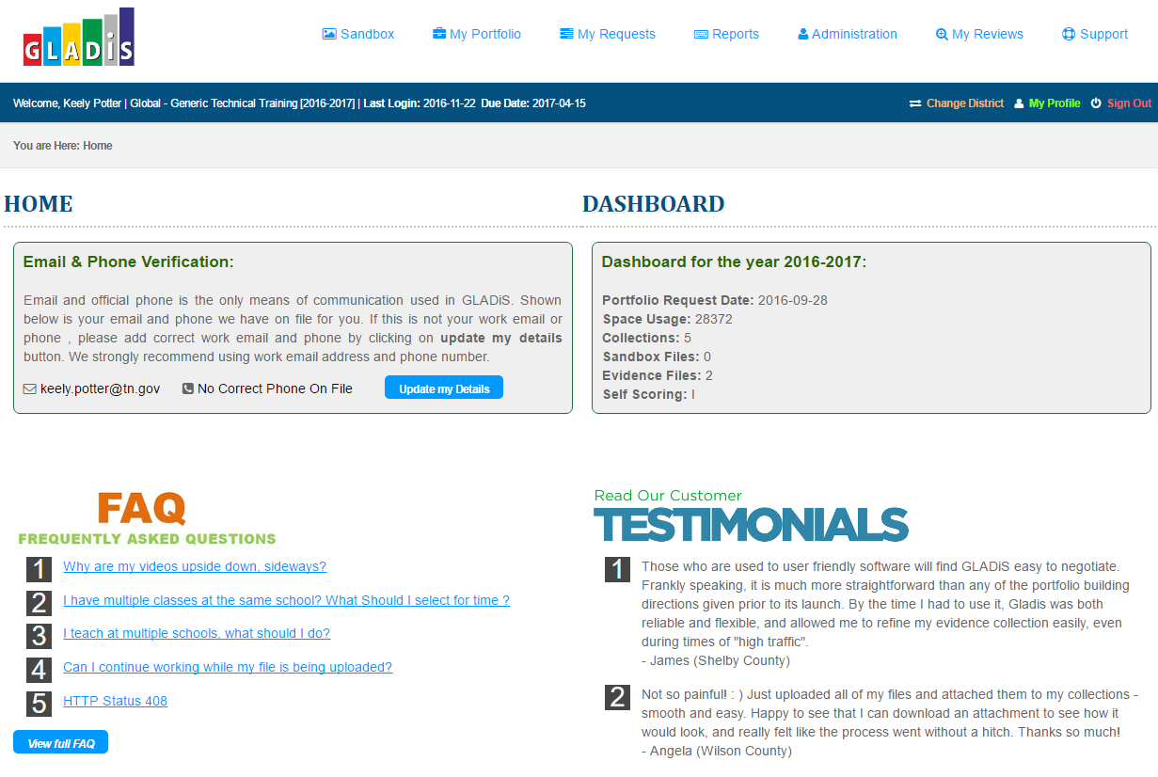
GLADiS Dashboard

Slide 7
Starting a Portfolio

Slide 8
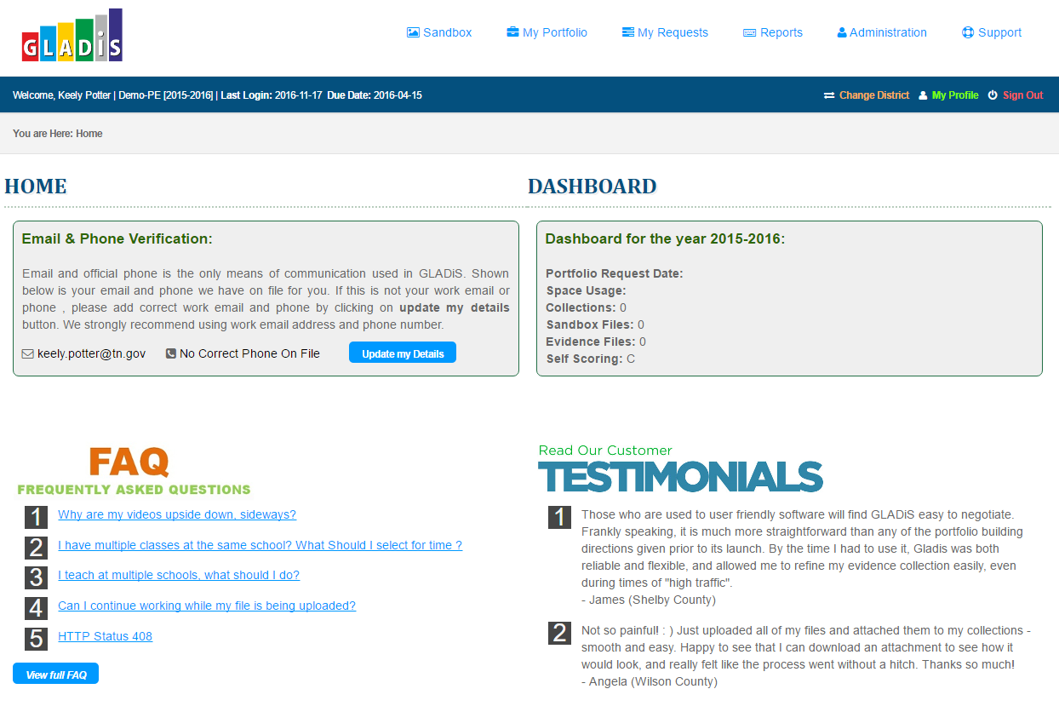
Select My Portfolio
Click here to start portfolio

Slide 9
Select Start Portfolio
Click Start Portfolio

Slide 10
Start Portfolio Step 1
Select the appropriate school year. If this is your first year in GLADiS you will only see this year as an option.

Slide 11
Start Portfolio Step 2
Select your details and click Continue

Slide 12
Start Portfolio Step 3
Complete details that describe frequency of instructional time and a course load summary and click Submit
Notes:
Step 3 notes: Within GLADiS (here), educators will complete an initial questionnaire about their teaching assignments that will provide their peer reviewers with proper context. In this section, educators can inform the peer reviewers about their course loads and any other information that the reviewers should consider to ensure a fair and equitable process. Educators should avoid disclosing their names or the name of their school(s).

Slide 13
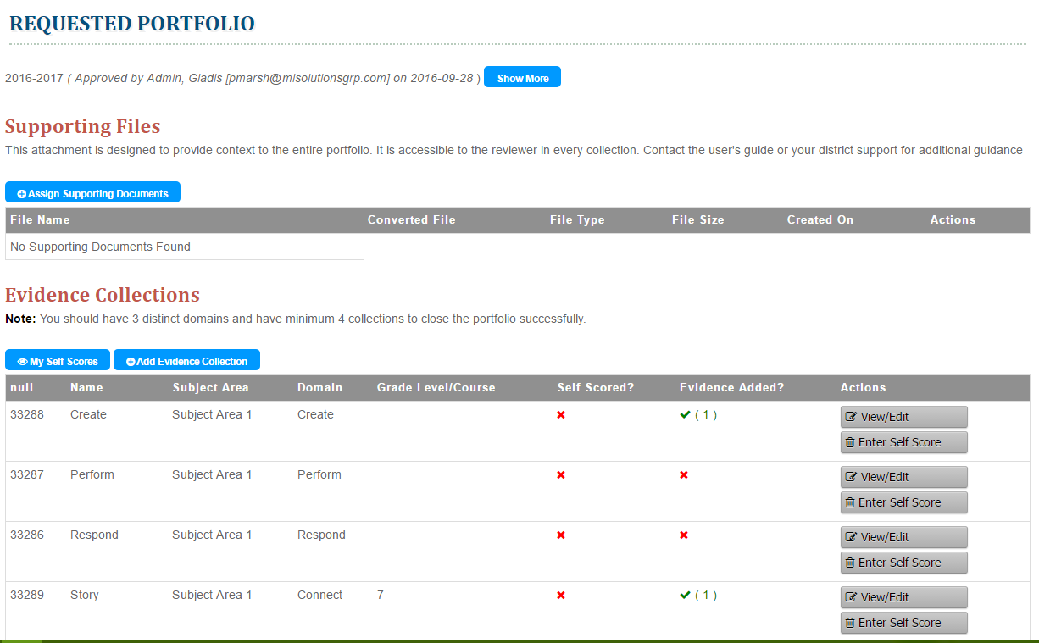
View or Edit Collection
Click View/Edit next to the collection you would like to edit

Slide 14
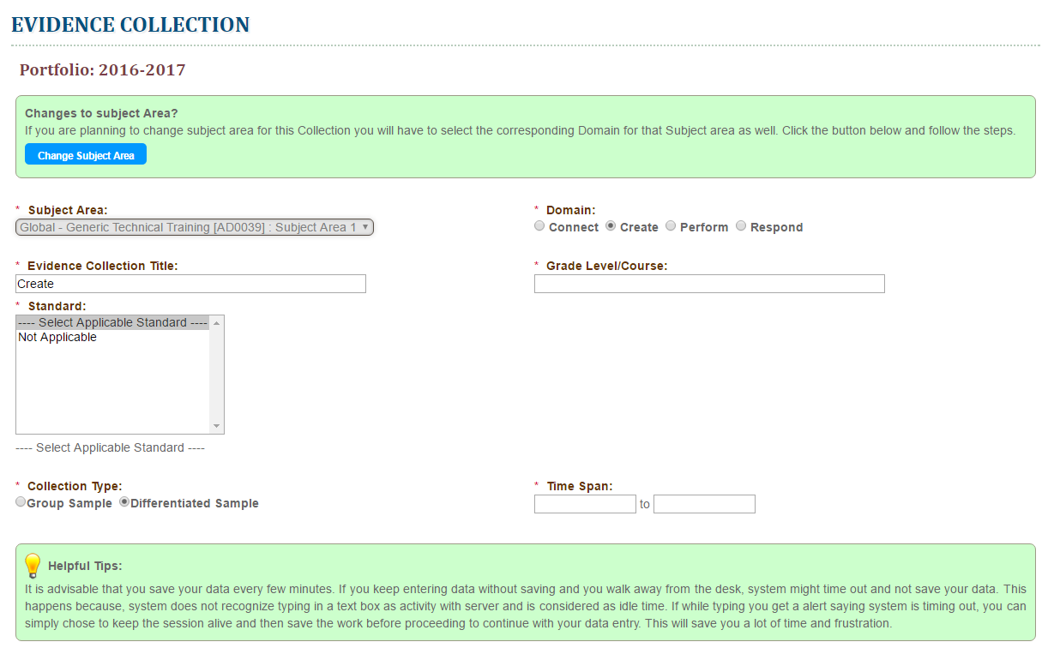
Select Portfolio Information
Enter all required information
Don’t forget to click Save Data at the bottom of the screen

Slide 15
Adding Files to Sandbox

Slide 16
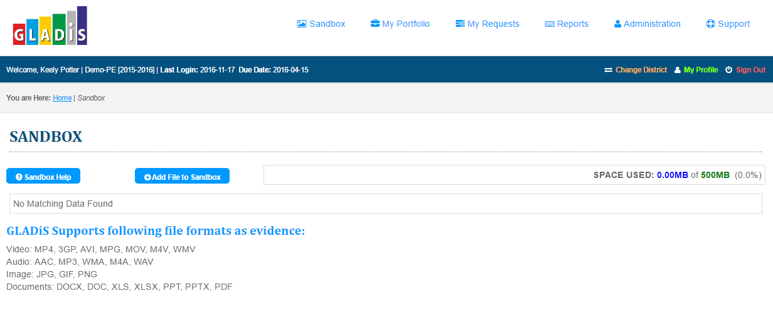
The Sandbox
To add files, videos, PowerPoints, etc. to add an evidence collection, they must be added to Sandbox first.
Notes:
Sandbox link is found at the top of the home page (in same area as “my portfolio”)To add files, videos, PPTs, pictures, etc. to an evidence collection, they must be added to Sandbox first.

Slide 17
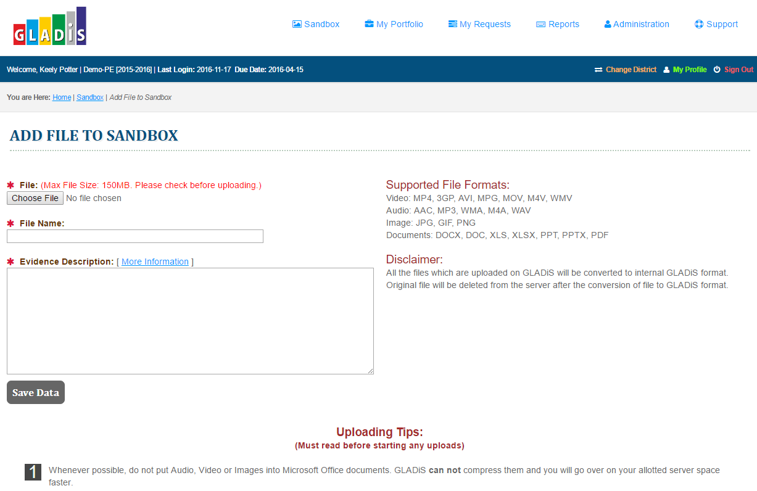
Add File to Sandbox
Choose file, name the file, and provide any additional information

Slide 18
Add File to Sandbox
Click Save Data

Slide 19
View, Edit, Delete Sandbox Files
View the file, edit information, or delete the file here
View uploaded video or audio here

Slide 20
Adding Files to My Portfolio

Slide 21
Add Sandbox Files to Portfolio
Click My Portfolio

Slide 22
Add Sandbox Files to Portfolio
Click View/Edit

Slide 23
Select Collection
Click View/Edit on the collection to upload evidence

Slide 24
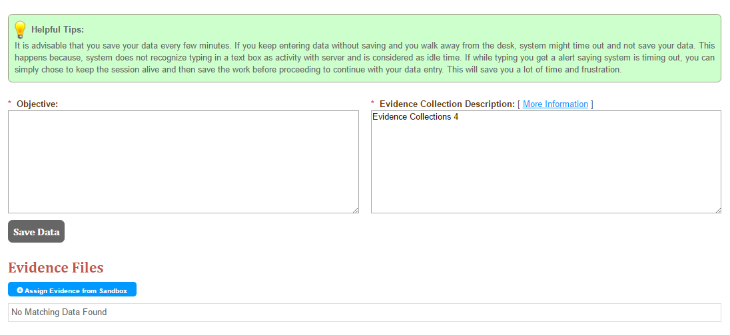
Assign Evidence from Sandbox
To move a file from Sandbox, click Assign Evidence from Sandbox

Slide 25
Assign Evidence from Sandbox
Click on the evidence to move from Sandbox to the Portfolio Collection
Then click Save Data

Slide 26
Assign Evidence from Sandbox
The file will appear under Evidence Files

Slide 27
Questions?

Slide 28
Contact Information
[NAME], TEAM coach
[EMAIL ADDRESS]
Keely Potter, director of teacher effectiveness
Keely.Potter@tn.gov
For content-specific support
TEAM.Questions@tn.gov

