Slide 1
Student Growth Portfolio
Fine Arts
Notes:
Welcome to the student growth portfolio presentation for fine arts teachers.

Slide 2
Notes:
Before portfolios were introduced, teachers in non-tested grades were assigned growth scores based on metrics that were often out of their immediate locus of control. The portfolio process allows non-tested teachers to demonstrate student growth that occurs in their own classroom with their own students. This growth is evaluated by peers intimately familiar with the standards and grade-level context. This process helps contribute to a high-quality education for all and helps Tennessee be the top state to become and remain a teacher

Slide 3
Agenda
Purpose
Benefits of the Student Growth Portfolio
Portfolios and TEAM Evaluation
Process
Creating a Shared Language, Spiraling Standards, and Flexibility
Process vs. Products
Major Work of the Grade Consideration
Fine Arts Portfolio and Rubrics
High-Quality Portfolio
Selecting a Model & Managing Student Work
Student Work Samples, Differentiated Grouping, & Purposeful Sampling
Portfolio Submission
Self-Scoring and Peer Review
Calculating Student Growth & LOE Generation
Platform
Platform Registration
Platform Support
Technical Requirements
Notes:
During this presentation, we will explore the purpose, process, and platform of the Tennessee student growth portfolio. We will dive deeply into the structure of the portfolio and explore how to create a high-quality portfolio to submit for review. We will also discuss the support available throughout the portfolio process for teachers. Please access the TEAM Portfolio Guidebook for Administrators and Teachers, the TEAM Portfolio Resource Guide for the Fine Arts, and the scoring rubrics specific to your teaching assignment. We will refer to all of these resources throughout the presentation.

Slide 4
Purpose
Notes:
Let’s explore the purpose and benefits of implementing student growth portfolios.

Slide 5
Benefits of Portfolios
Ownership of growth scores
Evaluation by peers familiar with the grade-level
Reflection of instructional practices
Differentiation of learning for various student groups
Identification of student growth in authentic tasks
Notes:
The student growth portfolio allows non-tested teachers to show academic growth of the students in their classroom and provides an opportunity for teachers to take personal ownership of that growth. Student growth is evaluated by peers intimately familiar with the standards and grade-level context. Portfolios help teachers reflect on their instructional practices, group students for differentiated learning, and to see student growth in authentic instructional tasks. Not only are students growing throughout the year, but through reflection of their instructional practices, teachers can grow, too.
As teachers, leaders, instructional coaches, principals, and district personnel explore and implement the contents of the following materials, it is recommended that they do so within a professional learning community (PLC) or other collaborative group that focuses on long-term and short-term planning, ongoing formative assessment, standards-based instruction, differentiated and targeted instructional practices, and student work. The art of analyzing student work when grounded in collaborative thinking, self-reflection, and differentiated instruction can have a profound impact on student academic growth.

Slide 6
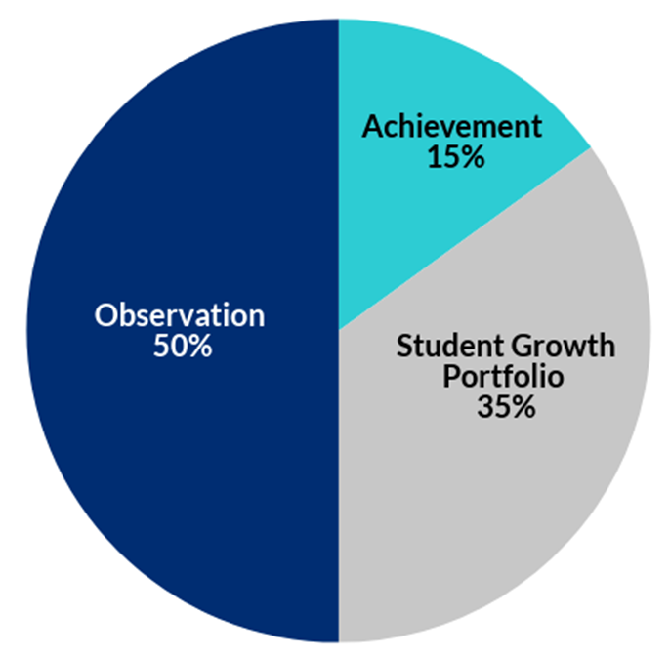
Portfolios in TEAM Evaluation
Portfolios generate an individual growth score for some non-tested teachers.
The growth score is essential in generating a teacher’s LOE.
Notes:
The portfolio process allows non-tested teachers to demonstrate student growth that occurs in their own classroom with their own students. The student growth score is essential in generating a teacher’s level of overall effectiveness, or LOE. Observations comprise 50% of a LOE, 15% of the LOE is student achievement , and the student growth portfolio makes up 35%.

Slide 7
Process
Notes:
Let’s discuss in depth the structure of the TEAM student growth portfolio, how to create a high-quality portfolio, the collection of work samples, scoring, and more. Please access the standards and scoring rubric associated with your discipline.

Slide 8
Shared Language, Spiraling Standards, and Flexibility
The portfolio creates a shared language amongst fine arts educators and across the core curriculum.
Teachers can return to standards throughout the year/semester/quarter as needed and explore the concepts with a deeper level of maturity and experience each time.
Flexibility empowers teachers and students to keep working for mastery.
Notes:
Fine arts standards share common language throughout all arts disciplines and across the core curriculum.
These standards were developed as spiraling standards, meaning teachers may return to standards throughout the year/semester/term as needed and explore the concepts with a deeper level of experience each time. This empowers teachers and students to be engaged in the artistic process by continually working for mastery, rather than the mindset of “we’ve checked this off the list.”

Slide 9
Process vs. Products
The fine arts standards emphasize the process of learning rather than the product.
Standards value the artistic process and artistic literacy.
In some cases, specific levels of achievement are mentioned (i.e. play a piece at _____grade level).
These are to be taken as examples.
Flexibility is inherent as arts education isn’t normalized across the state.
Notes:
The fine arts standards emphasize the process of arts learning and artistic literacy rather than the product. Tennessee standards do not prescribe a specific curriculum or delivery system for fine arts, thus providing flexibility for the myriad of fine arts programs and types of different arts learning opportunities and offerings across the state.
Notice that specific levels of achievement are mentioned within some of the standards. For example, music standards may include playing a piece of music at a specific level from a graded/prescribed music list or indicate specific scales or rudiments. Similarly, theatre standards may mention a specific theatrical work, visual art may mention working with specific materials, and dance standards may indicate specific styles. These indicators should be taken as examples. Remember, flexibility for curriculum and delivery styles is built-in to the fine arts standards. Indicators should not be treated as a checklist. We’ll discuss this a bit more later in the training.

Slide 10
Major Work of the Grade Consideration
The specific grade level and discipline within the arts will prioritize instructional time within certain foundations.
Not all of the content in a given grade/course is emphasized equally in the standards.
Some foundations require greater emphasis than others based on the depth of the ideas, the time that they take to master, and/or their importance to arts learning or the demands of college and career readiness.
Notes:
An important consideration from the fine arts standards is the concept of Major Work of the Grade, which states:
The specific grade level and discipline within the arts will prioritize instructional time within certain foundations. Not all of the content in a given grade/course is emphasized equally in the standards.
This means that you might spend more instructional time within some standards than you do others. This does not mean that some foundations are not important, only that the urgency towards mastery does not require the same amount of instructional time or focus depending on the course and experience level of the young artists.
This consideration can be found on page 5 of the standards document.

Slide 11
Fine Arts Portfolio
The implementation of the Fine Arts Portfolio reflects the fine arts standards.
Shared between all fine arts disciplines are the eleven foundations and four overarching domains.
P | Perform (music, dance, theatre); Present (visual arts); Produce (media arts)
CR | Create
R | Respond
Co | Connect
Notes:
The fine arts standards are deeply embedded in the fine arts portfolio scoring rubrics.
Each fine arts discipline shares eleven foundations and four overarching domains.
In music, dance, and theatre, the Perform domain is used, while Present is used in the media arts, and Produce is used for visual arts.
All disciplines share the domains Create, Respond, and Connect.

Slide 12
Creating a High-Quality Portfolio
Access the TEAM Portfolio Guidebook for Administrators and Teachers, p. 6.
Notice the bullet points that relate to practices you do on a normal basis to prepare for instruction and assessment in the classroom.
Notice the bullet points that relate to things specific to the portfolio that you do not do on a normal basis to prepare for instruction and assessment in your classroom.
Notes:
Access page 6 of the Portfolio Guidebook for Administrators and Teachers. Notice the bullet points that relate to practices you do on a normal basis to prepare for instruction and assessment in the classroom. Notice the bullet points that relate to practices specific to the portfolio that you do not do on a normal basis to prepare for instruction and assessment in your classroom. Reflect on how much of the portfolio process is something you already incorporate into your routine and what portions of the portfolio process is new to your routine and/or specific to the student growth portfolio.

Slide 13
Selecting a Model
Select four domains:
Perform/Present/Produce
Create
Respond
Connect
Notes:
The fine arts portfolio contains four evidence collections (student work artifacts). It is highly recommended that evidence collections represent at least two of the four domains (perform/present/produce, create, respond, and connect). Each collection of student work can only be scored for one of the domains.
Select the domains that will best reflect your instructional impact on student learning.
In cases wherein a fine arts teacher teaches multiple disciplines, the portfolio model submitted should represent student growth from the courses in which the teacher spends the majority of their time. If this distinction is unclear, teachers should work with their evaluator, building principal, and/or district portfolio leads to best determine the appropriate model to submit.

Slide 14
Managing Student Work
Student work includes, but is not limited to:
written student work,
video segments that demonstrate student performance or speaking,
audio recordings of student conversations, performed music, or think alouds, and
photographs of student work.
Student work may be stored on the following platforms:
Google
Dropbox
Box
OneDrive
Notes:
For the purposes of the student growth portfolio, student work can include, but is not limited to, written student work, video segments that demonstrate student performance or speaking, audio recordings of student conversations, performed music, think alouds, or photographs of student work.
Teachers are encouraged to store student work locally throughout the year, but also have the option to upload student work artifacts into the online platform at any time. Additionally, teachers may choose to store student work digitally. Google, Dropbox, Box, and OneDrive are all compatible with the TEAM portfolio platform, Portfolium. Teachers should check with their district about approved online storage platforms.

Slide 15
Point A Student Work Samples
Work samples are collected at the onset of learning
3 differentiated groups
Emerging
Proficient
Advanced
Score with associated rubric
Notes:
Each evidence collection must contain evidence from two points in time. After identifying the options and standards you would like to use for your portfolio collections, it is time to begin collecting student work samples. Standards-aligned tasks should be designed to allow students to demonstrate mastery or growth towards mastery of the standard. As part of regular instructional planning, a teacher should determine the best point in time to administer a standards-aligned task from which point A student work artifacts will be collected. Point A work samples should be collected at the onset of the learning related to the standard(s) being taught. The point A sample represents a pre-assessment skill/performance task while the point B sample represents the post-assessment skill/performance task.
After collecting your point A work samples, score them according to content-specific rubric(s). We will begin with Differentiated Samples the move to group samples. For differentiated samples, sort the student work into three differentiated groups: emerging, proficient, and advanced. The task-specific expectations, along with the scoring rubrics, will inform scoring and differentiated grouping.

Slide 16
Point B Student Work Samples
Collect work samples at the completion of learning.
Student work:
is from the same student/group as point A,
reflects the same standard as point A, and
is scored using the same rubric as point A.
Notes:
As part of regular instructional planning, a teacher should determine the point in time best to administer the portfolio standards-aligned task from which point B student work artifacts will be collected. At the completion of the learning of the same standard used for point A, the teacher should administer a standards-aligned task to collect work samples for point B. After developing or identifying the task, teachers should create task-specific expectations aligned to the scoring rubrics to assist in scoring point B student work artifacts. Point A and point B student work artifacts should be scored in terms of a preponderance of evidence for each standard based on the scoring rubrics. Point A and point B must measure the same standard. Point A and point B scores are compared to determine the overall growth score for the standards-based collection.

Slide 17
Purposeful Sampling
The process of selecting student work for inclusion in the portfolio collections after artifacts of student work for points A and B are collected
TEAM Portfolio Guidebook for Administrators and Teachers, p. 5
Differentiated Group: Emerging
Student | Point A Score | Point B Score | Levels of Growth
Student 1 | 1 | 3 | 2
Student 2 | 1 | 3 | 2
Student 3 | 1 | 3 | 2
Student 4 | 1 | 2 | 1
Student 5 | 2 | 3 | 1
Notes:
The teacher will then conduct purposeful sampling. Purposeful sampling is the process of selecting student work for inclusion in the portfolio collections. This means the teacher will determine which student work sample pairs (points A and B) to submit for each of the differentiated groups of a portfolio collection. The student work chosen for each differentiated group should be representative of the growth within that differentiated group. For example, there are five students in the emerging group at point A. Three students grow two performance levels from point A to point B, and two students grow one performance level from point A to point B. The teacher should select a sample to submit in which the student grew two performance levels. The teacher will repeat this process for each of the other differentiated groups (proficient and advanced) within this one portfolio collection. They will then follow the same procedure for selecting students for the other three portfolio collections, using the associated rubrics.

Slide 18
Group Sampling
Purposeful Sampling Requirements | Evidence Collection 1 | Evidence Collection 2 | Evidence Collection 3 | Evidence Collection 4
Evidence from varying populations (recommended: at least two collections containing differentiated samples) | Large ensemble (group sample) | Authentic performance task with data from two points in time from emerging, proficient, and advanced student work samples (differentiated sample) | Full class (group sample) | Authentic performance task with data from two points in time from emerging, proficient, and advanced student work samples (differentiated sample)
Domain (recommended: at least two of the four domains represented) | Perform | Create | Perform | Respond
Grade level/course | Fifth grade recorder ensemble | Second grade | Kindergarten | Fourth grade
Time span between Point A and Point B | Span of two weeks (or 6 instructional sessions as this class meets 3 times per week) | Span of six weeks (or six instructional sessions) | Beginning of the first semester until February | Span of three months (or 11 instructional sessions)
Notes:
A fine arts group sample collection is a sampling option available to music, theatre, and dance teachers and represents growth from ensembles or groups of students without specific regard to individual learning levels. Groups are specifically defined as more than one student performing the same piece of art at the same time.
When considering purposeful sampling, it is important to show how all students have grown, not just the high or low achievers. Group sampling is not available for visual arts or media arts.
This chart shows an example of how purposeful sampling can be approached with specific examples for a music teacher who teaches elementary/general music K–5.

Slide 19
Self-Scoring
Score student work according to the rubric.
Generate 3 separate scores.
The three scores from the point A artifact will be compared to the three scores for the point B artifact to determine the overall score for the standards-based collection.
Notes:
Once collected, each piece of student work should be self-scored for each standard in the chosen option. This will generate three separate scores at point A and three separate scores at point B to represent the three students in a differentiated sample. For group samples, only one score will be generated at Point A and one score at Point B.
The three scores from the point A artifact will be compared to the three scores for the point B artifact to determine the overall score for the standards-based collection.

Slide 20
Portfolio Submissions
All completed collections must be completed by the deadline. Please check the TEAM-tn.org website for current due date and time.
Ensure the following:
Points A and B are the same students.
Emerging, proficient, advanced are different students.
Each piece of student work is available and working (picture, PDF, audio, video, etc.).
No duplicated work is submitted.
All work within one collection refers to the chosen standard.
Notes:
Before the due date, carefully check all of the following: ensure that all point A work is from the same student or group as point B work, ensure that the emerging, proficient, and advanced work is from 3 different students in a differentiated sample, ensure that each piece of student work is available and working (including pictures, PDFs, and audio/video), ensure that no student work is duplicated or uploaded twice either for two different students/groups or the same work for point A and point B, and ensure that all work submitted within one collection refers to the chosen (same) standard.

Slide 21
Peer Review
Certified peer reviewers who are intimately familiar with the standards, rubrics, and grade-level content
Use the same scoring rubrics for points A and B
Discrepancy policy
TEAM Portfolio Guidebook for Administrators and Teachers, p. 9
Notes:
After submissions are complete, collections will be scored by peer reviewers who are intimately familiar with the standards, rubrics, and grade-level content. These peer reviewers will use the same rubrics as did the teacher for points A and B. These rubrics are auto-populated by the platform for the peer reviewer according to the standard or option chosen by the teacher.
If a discrepancy of more than one performance level exists between the teacher’s score and peer reviewer’s score for the average of a collection, a second peer reviewer scores the collection. If the second peer reviewer’s score is in consensus with either the teacher or the peer reviewer, the score in consensus stands. If there is no consensus of scores between the teacher, the first peer reviewer, or the second peer reviewer, then an expert reviewer conducts the final scoring. This information is detailed in the TEAM Portfolio Guidebook for Administrators and Teachers on page 9.

Slide 22
Peer Review Scoring Notes
Peer Reviewers will assign a differentiated group the score of 1 if one or more of the following occur:
no growth is demonstrated;
the same student/group work is:
uploaded for point A and point B
uploaded in another group sample within a collection, or
in each sample within a collection.
student work is missing;
the task is not aligned to the standard for one or more students;
student/group work is not produced by the student/group;
point A and point B are different students/groups; or
technology (audio/video/picture) is not available.
Notes:
It is critical that teachers check and double check the work they are submitting for any errors. Peer reviewers will score a differentiated group as level 1 if any of the following things occur. If no growth is demonstrated the work receives a score of 1. If the same student work is uploaded at point A and point B or the same student’s work is uploaded in two or more differentiated groups within a collection the score is a 1. If student work is missing the peer reviewer will score that group as a 1. If the task and student work is not aligned with the standard or cluster of standards chosen, the work receives a score of 1. If the work is not produced by the student, the work will receive a score of 1. And if the audio, video, and/or picture of student work is not available, the work will receive a score of 1. After uploading each collection, go back and ensure none of these things occur. Something as simple as accidently uploading the wrong student’s work can result in a lower score.

Slide 23
Calculating Student Growth and Teacher Effectiveness
Student growth score averages across the collections are used to calculate the teacher’s effectiveness score.
The teacher’s effectiveness score is the score that will be calculated as 35% of your LOE in TNCompass.
Scores are auto-calculated from the peer reviewer’s scores of your collections.
Notes:
Through the next several slides, you will see the process of calculating both the student growth score and the individual teacher’s overall effectiveness pertaining to the portfolio. The teacher effectiveness score is the score that will be calculated as 35% of the LOE in TNCompass. These scores are auto-calculated in the portfolio platform from the peer reviewer’s scores. The following slides are an example of how student growth and teacher effectiveness is calculated.

Slide 24
Scoring Algorithm
Student Scores and Equivalent Growth Within One Collection
Point B
3
Point A
1
Emerging Growth 2
Emerging Student
Point B
4
Point A
2
Proficient Growth 2
Proficient Student
Point B
5
Point A
2
Advanced Growth 3
Advanced Student
Notes:
Here is an example of student scores for points A and B as well as the growth score for each differentiated group within one collection. The emerging student for this collection scored at level 1 for point A and level 3 for point B, which gives this student growth of two levels. The proficient student in this collection scored at level 2 for point A and level 4 for point B, which gives this student growth of two levels. The advanced student for this collection scored at level 2 for point A and level 5 for point B, which gives this student growth of 3 levels.

Slide 25
Scoring Algorithm
Student Growth Within One Collection
Emergent Growth 2 levels
Proficient Growth 2 levels
Average growth in this collection:
2.33 levels
Advanced Growth 3 levels
average
Notes:
The growth of each differentiated group within one collection is then added together and divided by three to calculate the average growth for that one collection. As you can see here, the three differentiated groups’ levels of growth were added together for a total of 7 and then divided by three to get the average growth of this collection to be 2.33 levels of growth.

Slide 26
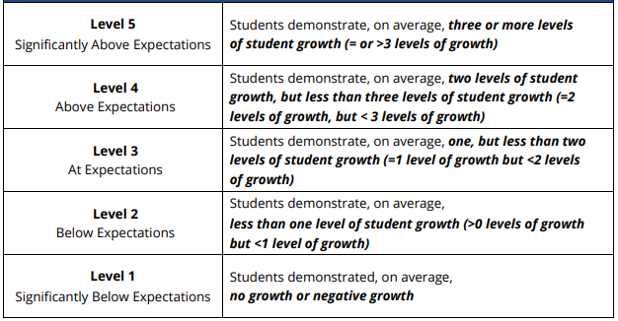
Scoring Algorithm
Student Growth Indicator Chart
Average growth in this collection:
2.33 levels
Notes:
That average of 2.33 levels of growth is then compared to the Student Growth Indicator Chart seen here. This chart is also available in the TEAM Portfolio Guidebook for Administrators and Teachers on page 10. As you can see the 2.33 levels of growth for this collection corresponds to student growth at Level 4 which is above expectations. This indicator states that students demonstrate, on average, two levels of student growth, but less than three levels of student growth in one collection. This process is repeated for the other three collections of the portfolio.

Slide 27
Scoring Algorithm
Collection 1
Student Growth Score
Level 4
Teacher Effectiveness Indicator Chart
Teacher Effectiveness Indicator | Student Growth Indicator Scores
Level 1 | 1.00 – 1.79
Level 2 | 1.80 – 2.59
Level 3 | 2.60 – 3.39
Level 4 | 3.40 – 4.19
Level 5 | 4.20 – 5.00
Collection 2
Student Growth Score
Level 4
Collection 3
Student Growth Score
Level 3
3.5
Collection 4
Student Growth Score
Level 3
Notes:
Once all collections have gone through calculations to determine the student growth score, it is time to calculate the teacher’s effectiveness score which will determine 35% of their LOE. As you can see here, we have student growth scores calculated for all collections. Collection 1’s student growth score is at Level 4. Collection 2’s student growth score is at Level 4. Collection 3’s student growth score is at Level 3. And collection 4’s student growth score is at Level 3. These 4 scores of student growth are then averaged and compared to the Teacher Effectiveness Indicator Chart. The average of the student growth scores for these four collections is 3.5 which corresponds to Level 4 because it is between 3.40 and 4.19. This teacher’s portfolio teacher effectiveness score is a Level 4. That is the score that will calculate into their overall LOE as 35% for growth. Observations will account for 50% and the selected achievement score will account for the remaining 15% of the overall LOE calculated in TN Compass.

Slide 28
Platform
Notes:
Let’s talk about the platform, Portfolium, where this work is stored and reviewed.

Slide 29
Platform Support: Tech Requirements
Chrome and Firefox are best for Portfolium access.
Microsoft Edge is also supported.
Internet Explorer is NOT a supported browser.
Portfolium supports multiple file formats for images, documents, and audio/video.
Ensure the most updated version internet browsers and media software (e.g., Quicktime, Windows Media Player, etc.). is installed.
Notes:
Before we dive into the platform itself, let’s discuss technology requirements. Chrome and Firefox are the best browsers for Portfolium access, however Microsoft Edge is also supported. Internet Explorer it is not a supported browser. Portfolium supports multiple file formats for images, documents, audio, and video artifacts. It is important to ensure that you are working with the most updated version of internet browsers and media software (such as QuickTime, Windows Media Player, etc.).

Slide 30
Platform: Portfolium
team-tn.org/portfolio-resources
portfolium.com/login
District Portfolio Leads (DPL) create roster then teachers finish registration
Notes:
You can find the link to the platform at the bottom of the Tennessee Portfolio Resources page on the TEAM-TN website (team-tn.org/portfolio-resources). The direct link for the platform is edu.portfolium.com/login/growth. At the beginning of each year, District Portfolio Leads create a roster of all teachers using the portfolio growth model. Until this happens, teachers will be unable to access the current year in the platform. For teachers new to the portfolio growth models, links will be sent to your email with instructions to log-in to Portfolium.

Slide 31
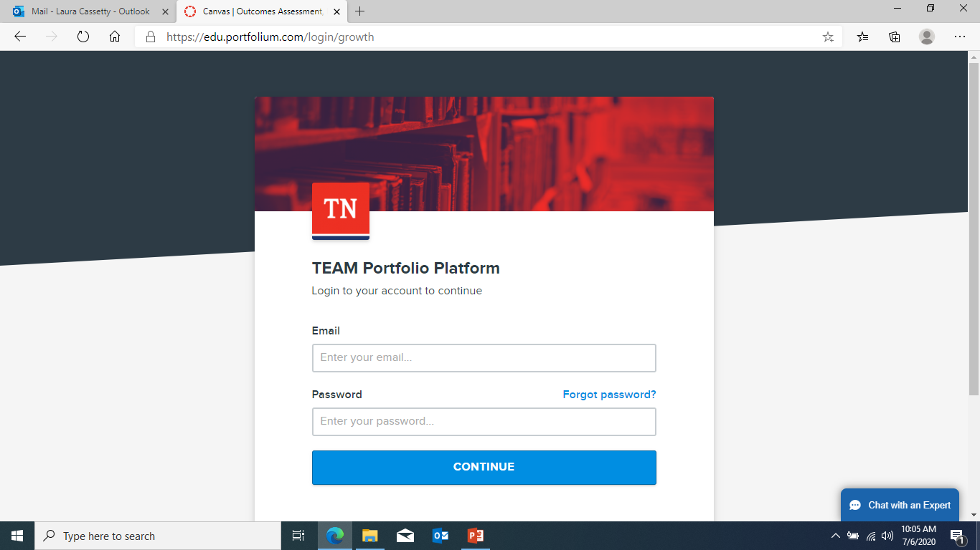
Platform Registration: Log In
Notes:
When you get to the Portfolium website, you will be asked to log-in and register for the current year. When you register, you are asked to select the year, your role, your portfolio model, and your collections. Let’s walk through this process now.

Slide 32
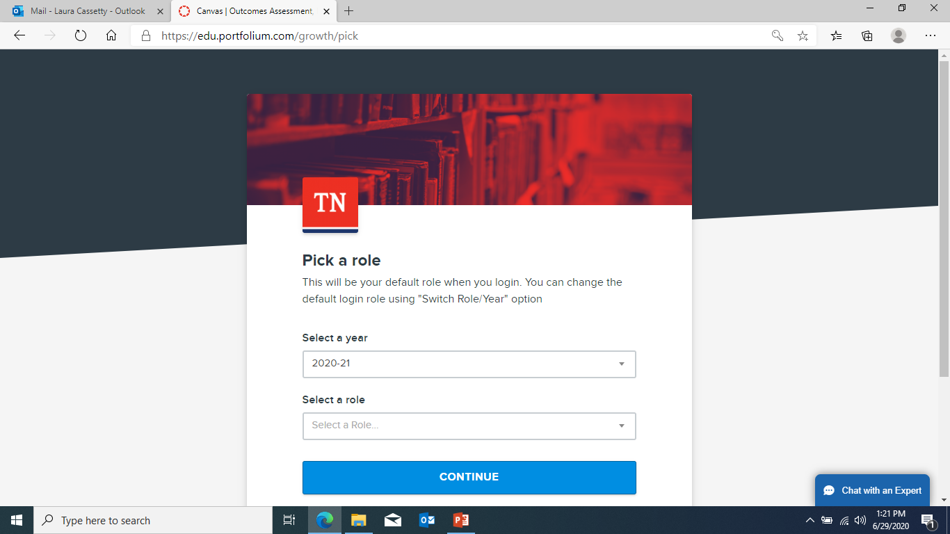
Platform Registration: Year and Role
Notes:
After logging in, you are asked to select the year and your role. The 2020-2021 school year is shown here, and you will select the role of “teacher” to move on to the next step.

Slide 33
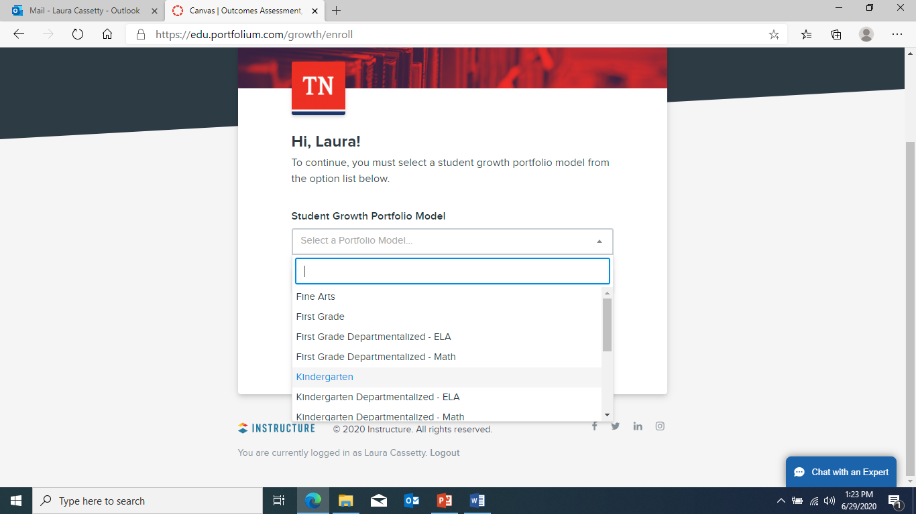
Platform Registration: Portfolio Model
Notes:
You will then be asked to select which student growth portfolio model you will be submitting.

Slide 34
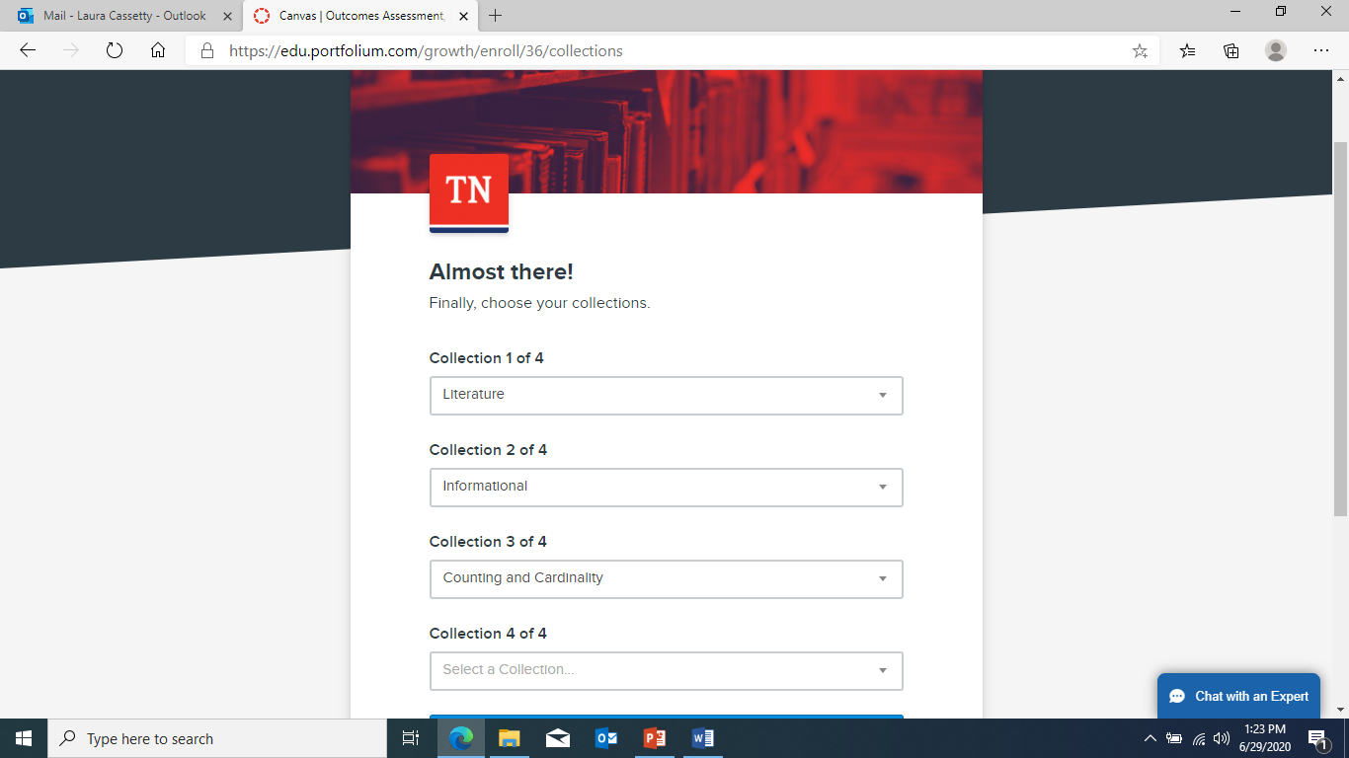
Platform Registration: Collections
Notes:
Once you have selected your portfolio model, you will be able to choose your collections.

Slide 35
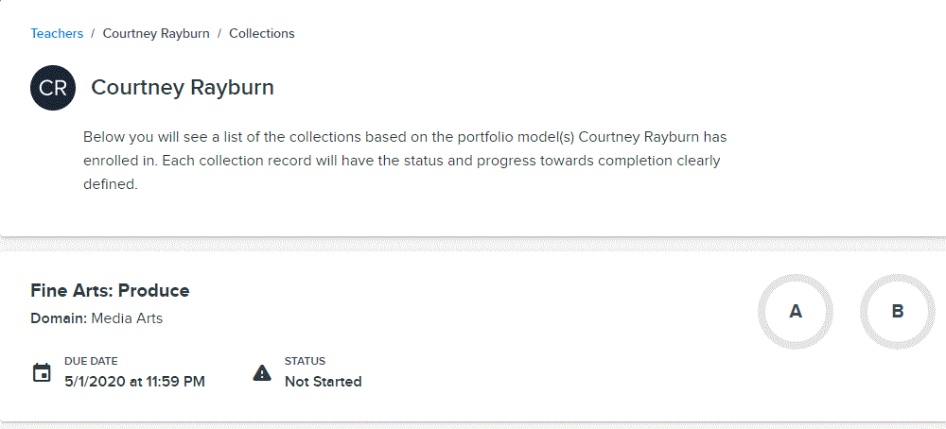
Platform Registration: Done!
Notes:
Hooray! You have completed the registration process in Portfolium. Here you can see your collections are ready for you to start working on.

Slide 36
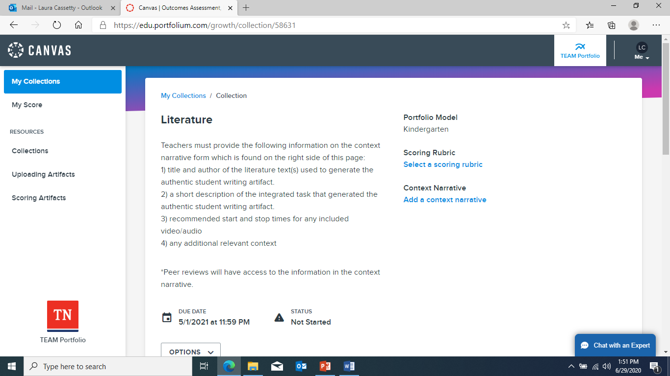
Choose Scoring Rubric
Notes:
If you click on the collection title, it will take you to this screen. This is where you will choose the rubrics you want to use for scoring your student work and put information in your context narrative. Clicking on “Scoring Rubric” will bring up a screen/list to choose which standard or cluster of standards you want to use to self-score the student’s work.

Slide 37
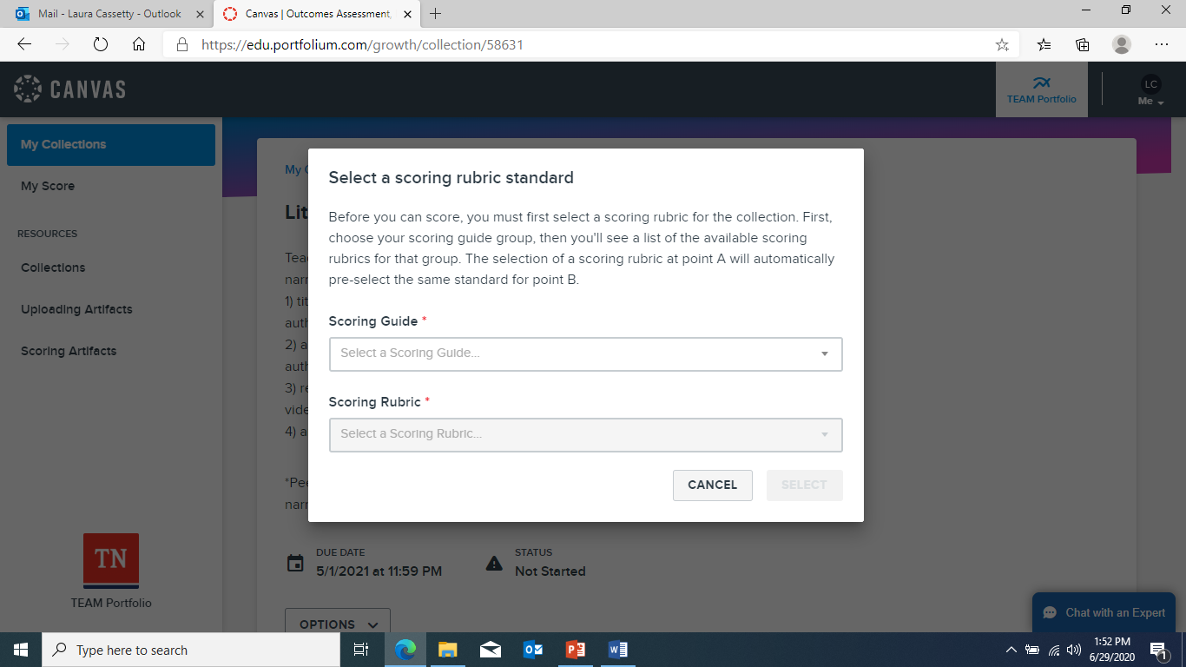
Choose Scoring Rubric
Notes:
For scoring guide, select the portfolio model or collection you are working on. Select the standard or cluster of standards where it says “scoring rubric.”

Slide 38
Context Narrative
Notes:
After selecting the appropriate rubric or rubrics, you can come back to this screen to begin working on your context narrative. You may choose to begin working on the context narrative early in the year, or you may choose to wait until you are ready to upload and score all of your students’ work. Whenever you are ready to work on this, simply clicking on “Context Narrative” will take you to a text box in which to write the information peer reviewers need to know in order to score your students’ work. It is highly recommended that teachers complete a context narrative form in the platform. Context narratives allow teachers to provide critical contextual or instructional information. Instructions for content-specific information that should be included on a context narrative are available in the platform. Context narratives should contain objective information only. Please refrain from including scoring information in context narratives.

Slide 39
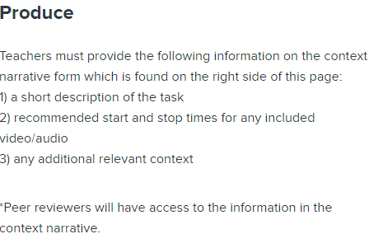
Context Narrative
Notes:
When you complete your context narrative, be sure to type in all the information the peer reviewer needs to know about the collection, both points A and B. Here are some basic questions you may want to answer in your context narrative. You can even copy and paste these questions into your context narrative so you remember what questions to answer.

Slide 40
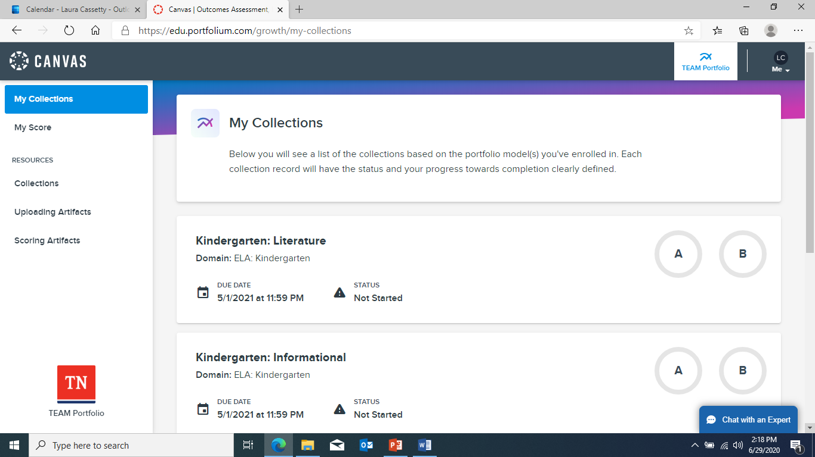
Ready for Uploading
Notes:
When you are ready to upload your students’ work, click on the appropriate collection.

Slide 41
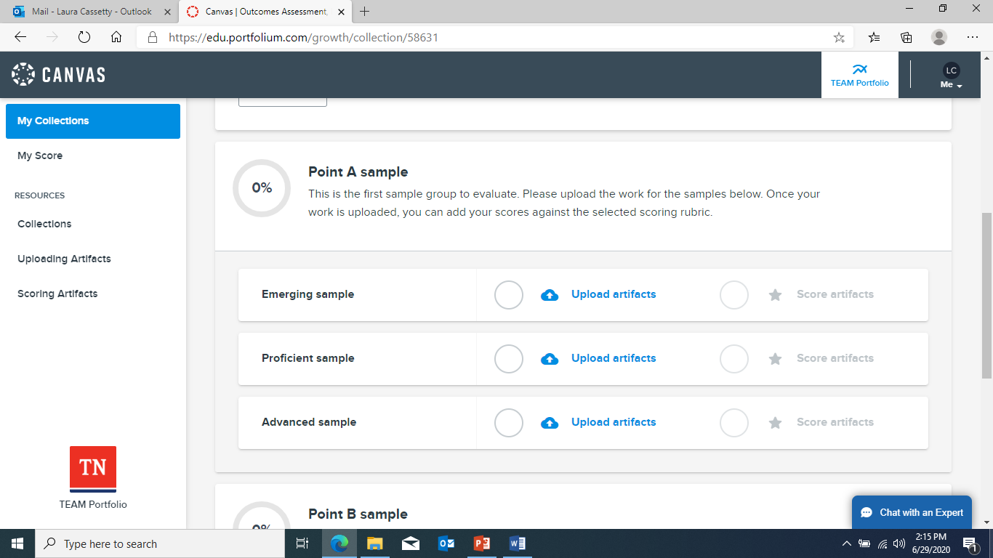
Uploading Student Work
Notes:
At the top you will see information for the rubric and context narrative, but if you scroll down, you will see where you will upload your student work artifacts. Be sure that the correct rubric has been selected and the appropriate work is uploaded for the correct student in the correct collection. If any of these things are wrong, it will result in a level 1 score across the differentiated groups affected. When you are ready to upload, simply click “upload artifacts” for the appropriate differentiated sample or group.

Slide 42
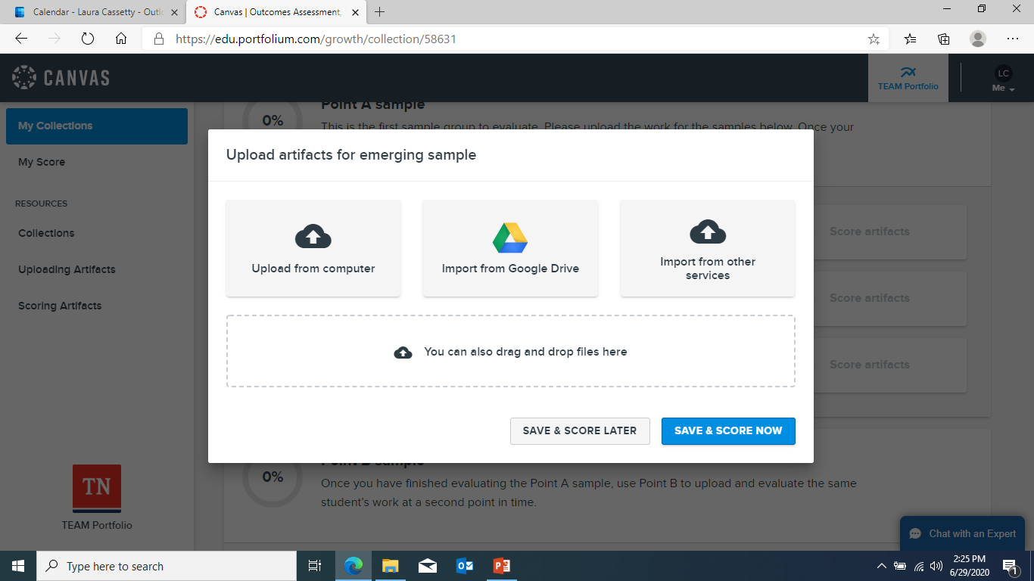
Uploading Student Work
Notes:
After clicking “upload artifacts” for the emerging student at point A, this screen comes up to choose the file to upload. You can choose to upload from your computer, import from Google Drive, import from other services, or you can drag and drop the file in the rectangle. As you are creating and saving your students’ work artifacts, be sure that the file formats are compatible with the Portfolium platform.

Slide 43
Supported File Formats
Images | Documents | Presentations | Spreadsheets | Audio/Visual
.png, .svg, .tiff, .bmp, .gif, .jpeg, .jpg, .psd | .doc, .docx, .odt, .ott, .rtf, .txt, .pdf | .odp, .ppt, .pptx | .ods, .xls, xlsx | .mp4, .mp3, .wav, .ogg, .wma, .aac, .mpeg, .mpg, .mov, .wmv, .avi, .3gp, .flv, .webm, .m2v, .m4v, .vob, .ogv
https://community.canvaslms.com/docs/DOC-18228-929791176522
Notes:
Here are several file formats that are compatible with the Portfolium platform. Ensure that you are creating and saving your students’ work in these formats so that you are able to upload the artifacts into the platform when you are ready. If you aren’t sure if your file format is compatible, you can check the link above or ask Portfolium using the chat feature.

Slide 44
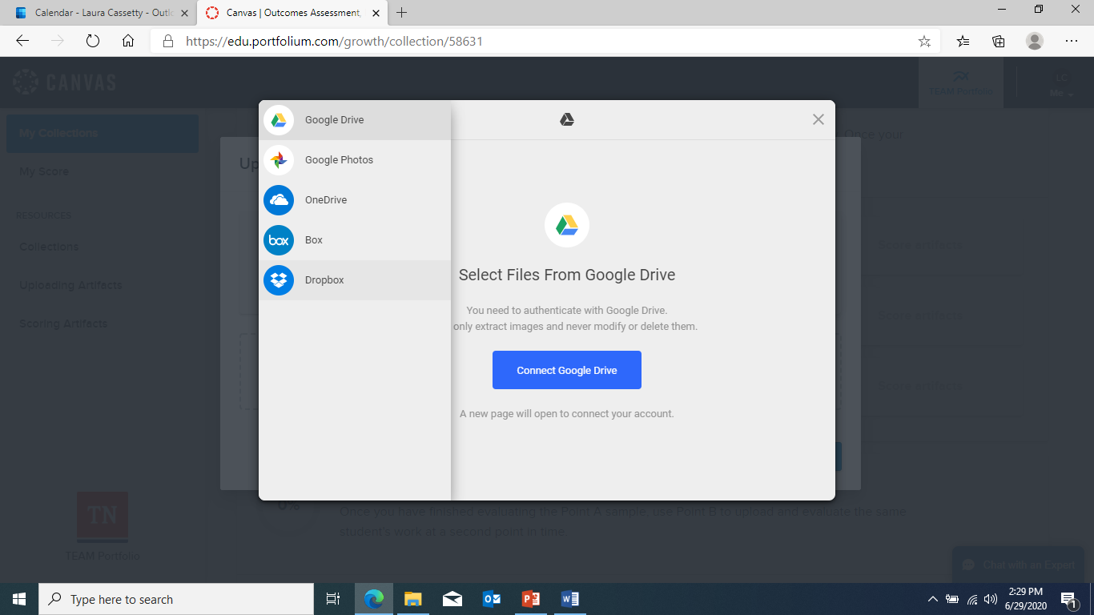
Uploading Student Work
Notes:
Besides storing artifacts on your computer or in Google Drive, there are other services compatible with Portfolium. These are the options that come up if you select “import from other services.” These services include Google Photos, OneDrive, Box, and DropBox.

Slide 45
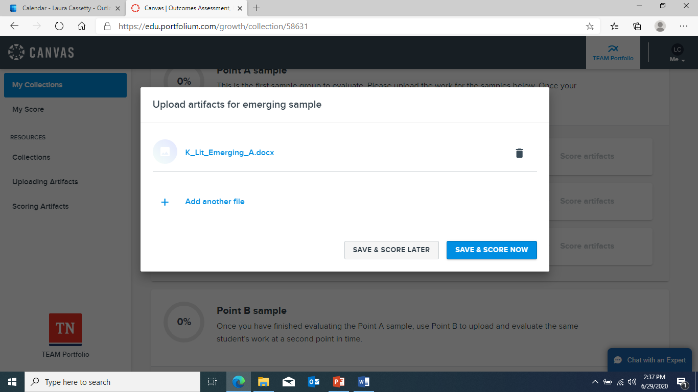
Uploading Student Work
Notes:
Now that my student artifact has been uploaded, I can choose to save and score later or save and score now.

Slide 46
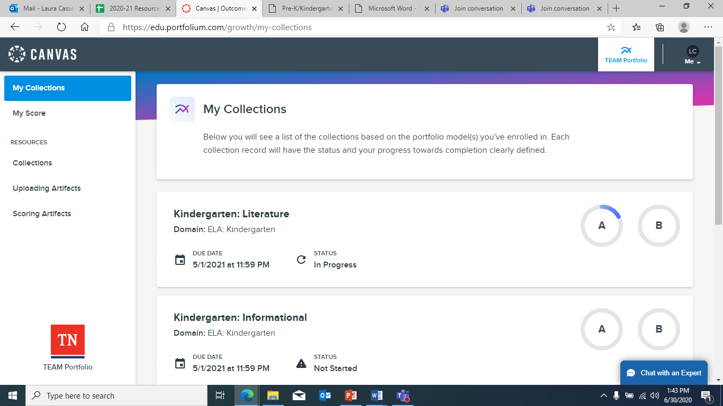
Status Wheels
Notes:
You can see the status of each collection by looking in several places. First the status of each collection is listed beside the due date. You can also see a visual of these in the status wheel. For example, I have started my Literature Point A uploads, so I have a small portion of the circle filled in and my status says “in progress.” If you look at the status of my Informational collection, it says “not started,” and I have no blue in the wheels around A or B, which means I have not started working on that collection by uploading or scoring artifacts.

Slide 47
Platform Support: Tutorials
Notes:
Portfolium provides tutorials on how to view your collections, upload student work artifacts, and scoring student work artifacts. These tutorials can be found on the left side of your screen.

Slide 48
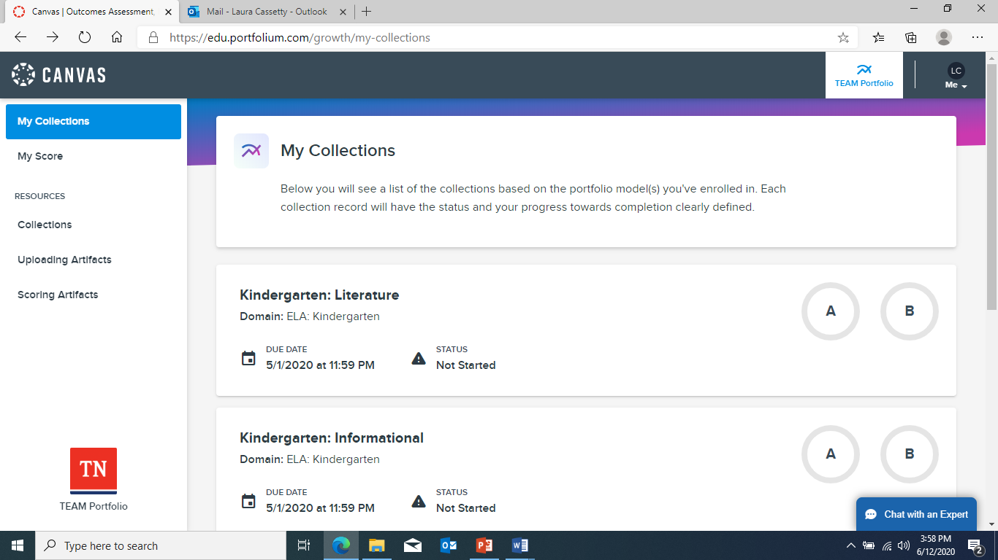
Platform Support: Chat
Notes:
Portfolium also has a chat feature in the lower right hand corner. The experts can help you with many technology-related or “how-to” questions about the platform.

Slide 49
Teacher Support
Consult the rubric, scoring notes, standards, the TEAM Portfolio Guidebook for Administrators and Teachers, the TEAM Student Growth Portfolio Resource Guide for Fine Arts, this training video, and any other resources available at https://team-tn.org/portfolio-resources/.
Confer with a teaching partner.
Contact your district portfolio lead.
Contact Portfolio.Questions@tn.gov.
Notes:
Throughout the year, if you find that you have further questions or need further guidance, please consult the rubric, scoring notes, standards, the TEAM Portfolio Guidebook for Administrators and Teachers, the TEAM Student Growth Portfolio Guide for the Fine Arts, this training video, and any other available resources at team-tn.org/portfolio-resources. It is sometimes helpful to confer and discuss these topics with a teaching partner. You can also contact your district portfolio lead or contact portfolio.questions@tn.gov.

Slide 50
Thank you!
Thank you for your continued partnership with the department and for all that you do for Tennessee students.

